Slide 1
Data Management for ML

Slide 2
Introduction to Data Management for ML
Data management is essential for supporting machine learning (ML) solutions.
This presentation explores the considerations, architecture, and tools required for efficient ML data management.
The goal is to provide scalable, secure, and flexible platforms to handle ML workloads.
Proper data management ensures that machine learning models can be trained effectively and produce reliable results.
It plays a crucial role in optimizing resources and improving overall model performance.

Slide 3
Data Management Considerations for ML
ML solutions require careful handling of data at all stages, from ingestion to model deployment.
Data validation, cleaning, enrichment, and labeling are crucial in the early stages of the ML lifecycle.
The data platform must support discovery, querying, retrieval, and scalable processing of large datasets.
Data governance, including security and privacy, is important to ensure compliance with regulations.
Automated processes for data validation and enrichment help in reducing errors and maintaining consistency.

Slide 4
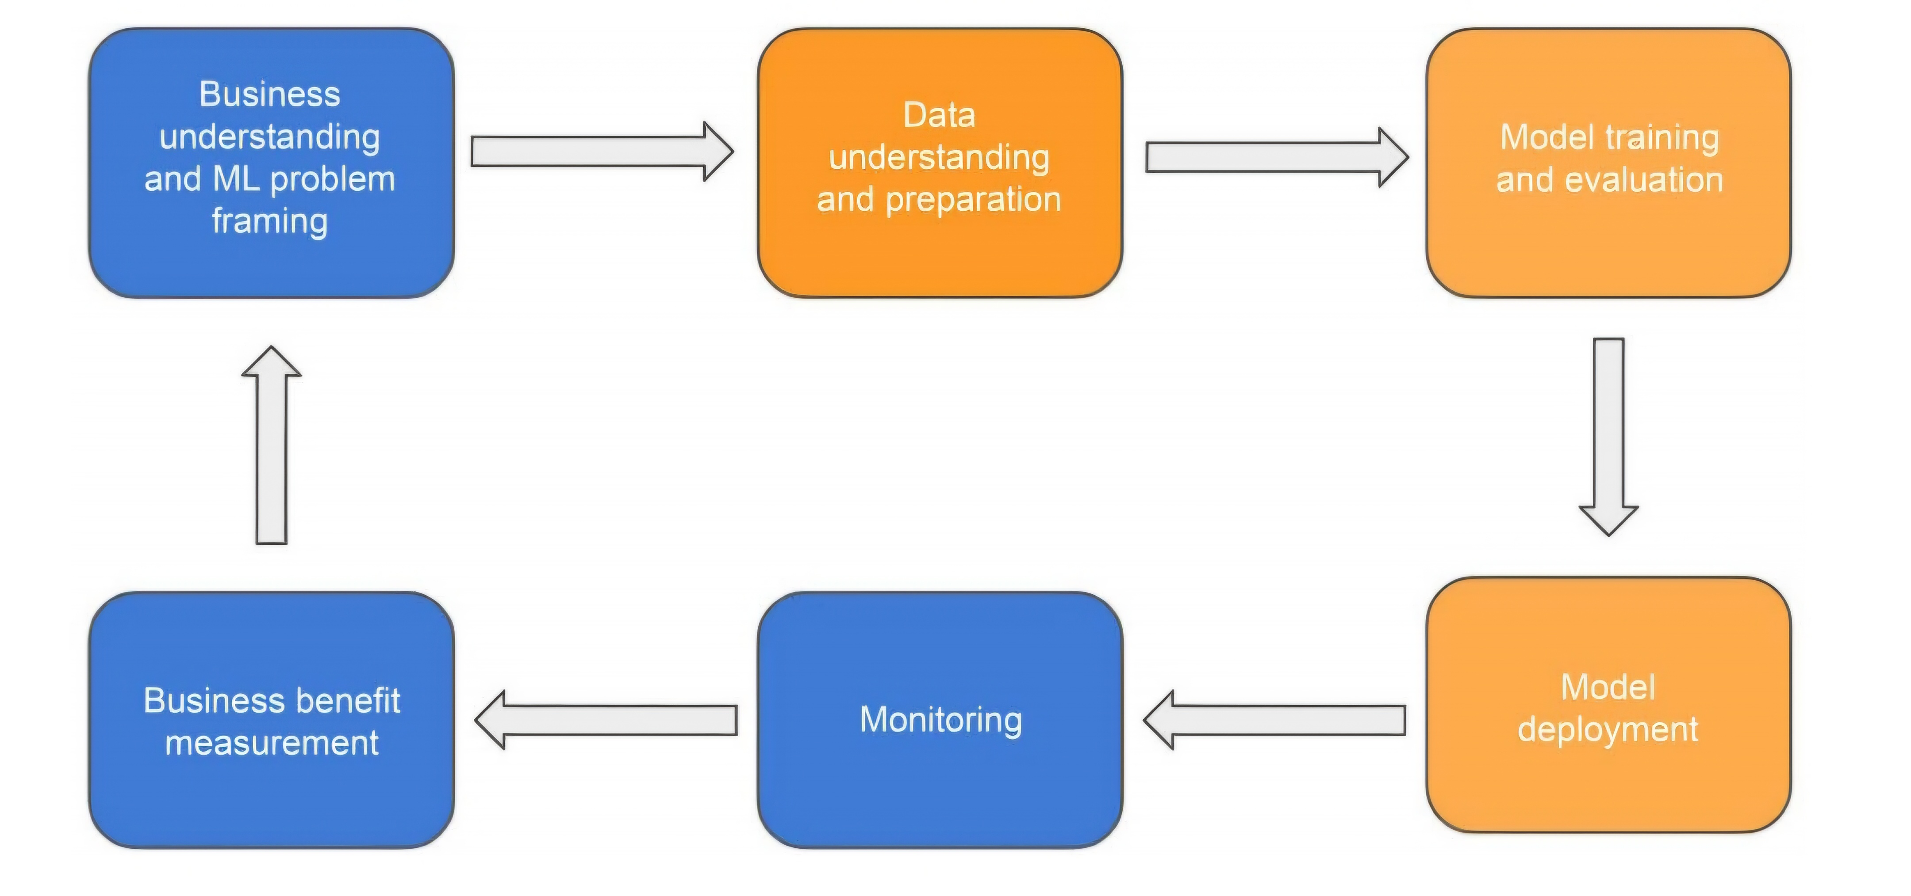
Intersection of data management and the ML lifecycle

Slide 5
Data Architecture for ML
Data management architecture varies depending on the scale of ML initiatives.
For small-scale projects, a purpose-built pipeline can handle structured data from limited sources.
Large-scale projects require more robust architectures that support both structured and unstructured data.
A data lake architecture is commonly adopted for large-scale ML initiatives.
Data architectures should be designed to accommodate both batch and real-time data processing for flexibility in ML workflows.
Ensuring data governance and security in the architecture is critical when handling sensitive or large-scale datasets.

Slide 6
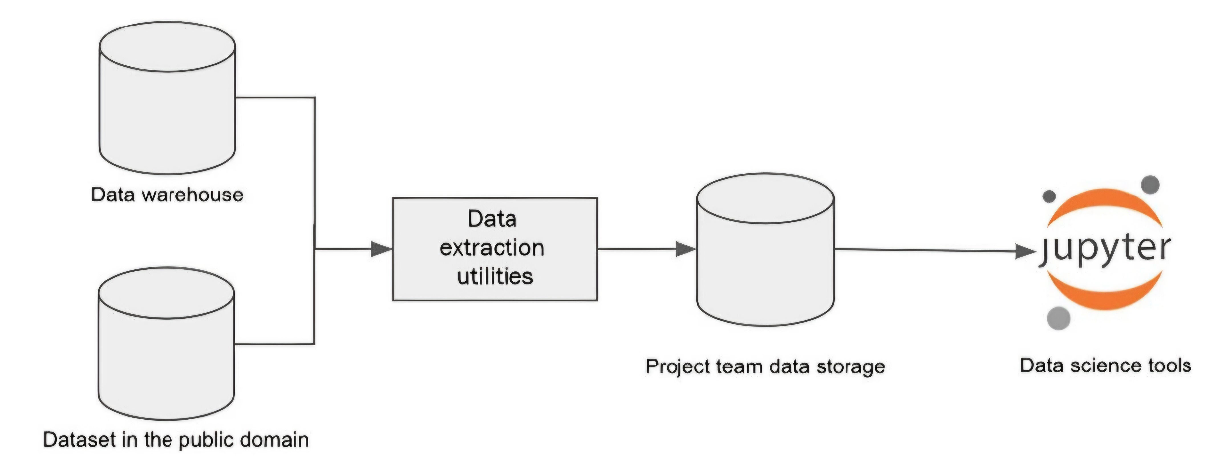
Data architecture for an ML project with limited scope

Slide 7
Enterprise Data Management Architecture
Enterprise data management supports both analytics and ML, requiring data ingestion from multiple sources.
It handles structured, semi-structured, and unstructured data, typically through a data lake.
Centralized data management enables seamless access, processing, and security across departments.
This architecture allows organizations to scale their data processing efforts and provides a foundation for advanced analytics.
By integrating ML and analytics in a unified system, teams can collaborate more effectively using shared data resources.

Slide 8
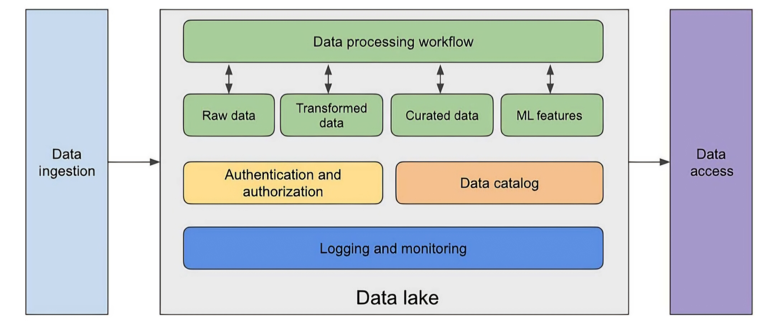
Enterprise data management

Slide 9
Data Storage and Management
Cloud object storage, like Amazon S3, is ideal for storing vast amounts of structured and unstructured data.
Data lakes facilitate the organization of data across lifecycle stages, including raw, curated, and feature data.
Data should be organized into zones such as landing, raw, and curated zones to optimize processing.
Organizing data into zones helps streamline processing and ensures that raw data is transformed efficiently.
Versioning in storage helps track data changes and ensures reproducibility for machine learning tasks.

Slide 10
AWS Lake Formation
AWS Lake Formation simplifies data lake management, providing tools for data ingestion, transformation, and security.
Core capabilities include automated data cataloging, transformation, and access control.
Lake Formation integrates with AWS Glue for catalog management and ETL processing.
Lake Formation helps ensure that data governance is maintained while providing easy access for data scientists and analysts.
It also accelerates the setup of secure data lakes by automating time-consuming tasks such as policy setting and permissions management.

Slide 11
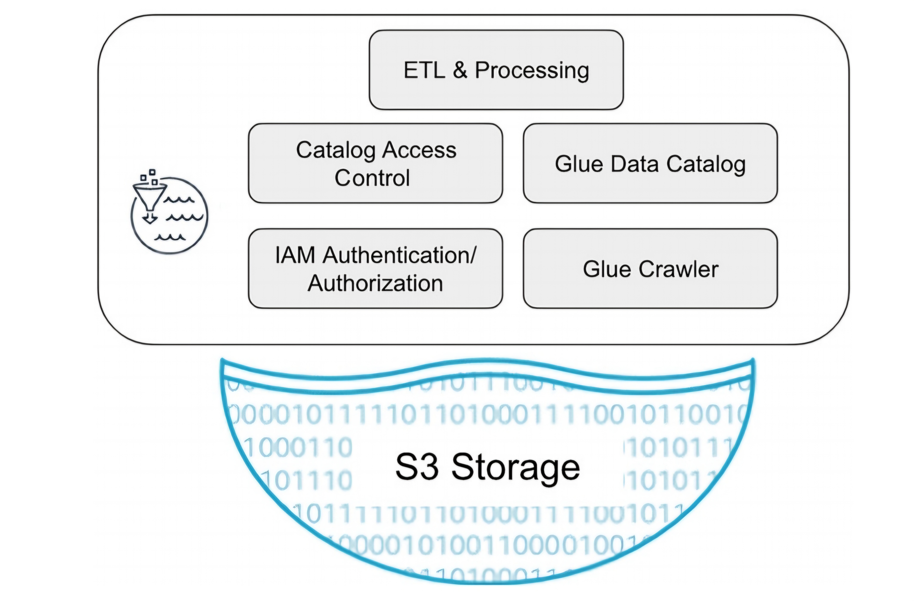
AWS Lake Formation

Slide 12
Data Ingestion for ML
Data ingestion bridges data sources and storage, handling structured, semi-structured, and unstructured data.
Tools like AWS Glue and Kinesis handle batch and real-time data ingestion, respectively.
Ingestion tools must support various formats and ensure scalability and security.
Security measures, such as encryption, should be implemented during data ingestion to protect sensitive information.
Ingestion pipelines should be designed to handle schema changes and data format transformations efficiently.

Slide 13
Kinesis Firehose
Kinesis Firehose automates the loading of streaming data into data lakes, offering support for various data sources.
It integrates with AWS Lambda for custom data processing and provides real-time data streaming capabilities.
Kinesis can stream data to Amazon S3, Redshift, and OpenSearch.
Kinesis Firehose can scale automatically to match the incoming data volume, ensuring high availability.
It also supports data transformation before storage, which helps streamline the data processing pipeline.

Slide 14
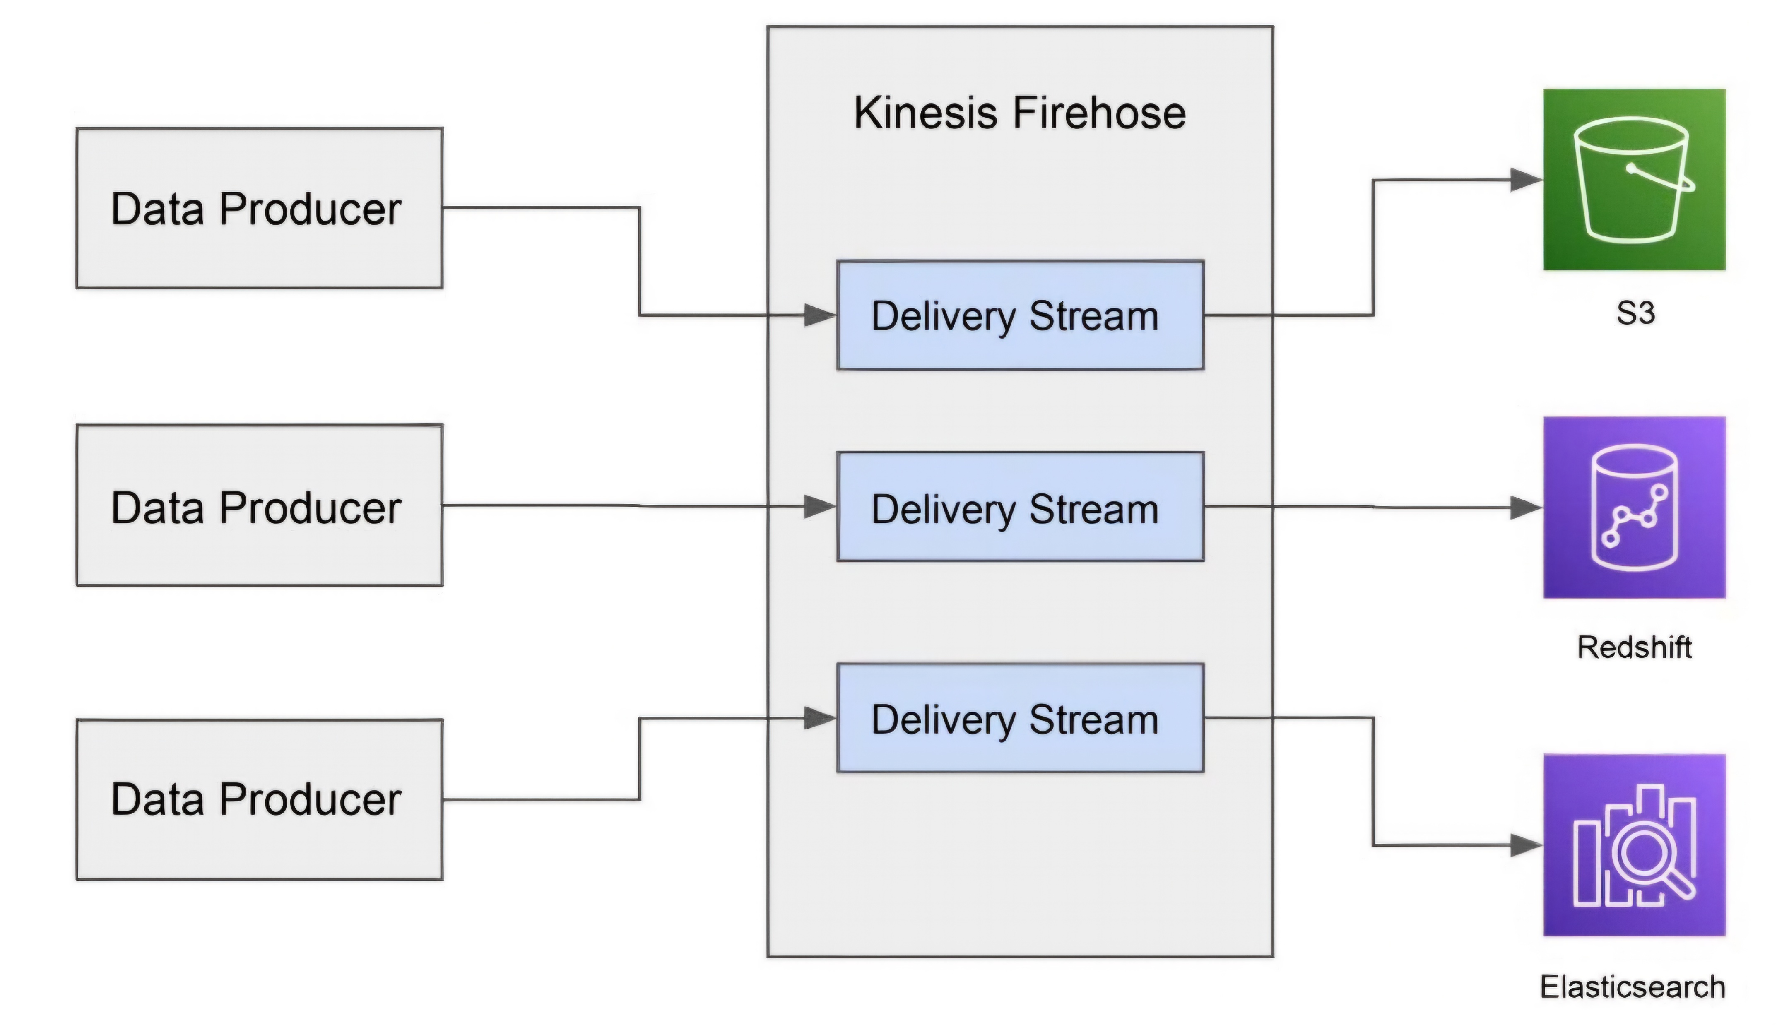
Kinesis Firehose data flow

Slide 15
AWS Glue for Data Ingestion
AWS Glue is a fully managed ETL service that supports data ingestion from multiple sources into data lakes.
It supports event-triggered and scheduled data ingestion and can process data with Python or Spark.
AWS Glue integrates with other AWS services like S3 for seamless data movement.
Event-triggered ETL jobs are especially useful for real-time data processing.
AWS Glue’s seamless integration with other AWS services enables efficient data management across the entire lifecycle.

Slide 16
Data Cataloging
Data catalogs provide a centralized repository of metadata, enabling efficient data discovery and management.
AWS Glue’s Data Catalog can automatically discover and catalog datasets, making them easier to search and query.
Data catalogs support ML by improving visibility into available datasets and their characteristics.
A well-maintained data catalog enhances collaboration across teams by providing a unified view of available datasets.
It also plays a key role in governance by ensuring that only authorized users have access to sensitive datasets.

Slide 17
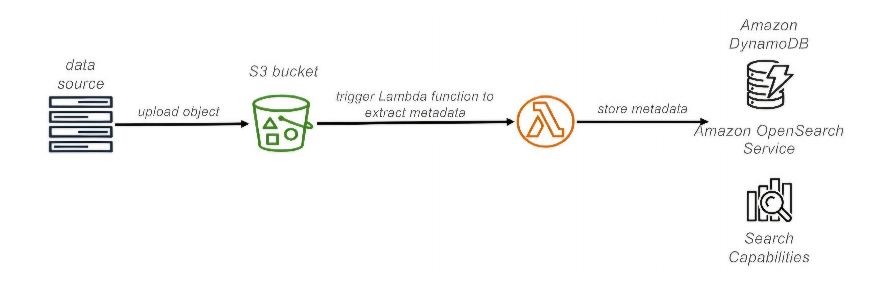
Custom data catalog solution

Slide 18
Data Processing for ML
Data processing is a crucial step in preparing raw data for model training and includes tasks like cleaning, transformation, and feature engineering.
Common tools for data processing include Python, Apache Spark, and AWS Glue ETL.
Data processing frameworks must be scalable and integrated with storage and catalog services.
Efficient data processing frameworks reduce the time and effort required for feature engineering, a key step in model building.
Automated workflows for data processing can help ensure data quality and consistency.

Slide 19
Data Versioning
Data versioning ensures that different iterations of datasets are tracked and managed for reproducibility.
Amazon S3 supports versioned buckets, allowing for multiple versions of datasets to be stored.
Purpose-built tools like DVC or Git LFS can also be used to manage dataset versions.
Tracking different versions of data helps data scientists reproduce results and maintain model accuracy over time.
Data versioning is crucial for collaboration, especially when multiple teams are working on the same dataset.

Slide 20
Special Databases for ML: Vector Databases
Vector databases efficiently store, index, and query high-dimensional vectors, commonly used in ML for tasks like similarity search.
These databases are especially useful in applications involving embeddings, such as natural language processing and image recognition.
Vector databases provide fast querying capabilities, which is critical for real-time recommendation systems.
Examples include FAISS, Milvus, and Pinecone, which offer scalability and high-performance similarity search.

Slide 21
Special Databases for ML: Graph Databases
Graph databases store and manage graph-structured data, representing entities and their relationships as nodes and edges.
Graph databases are widely used in ML tasks involving complex relationships, such as social network analysis and fraud detection.
Popular options include Neo4j and Amazon Neptune, both offering efficient querying and traversal of graph data.
Graph databases are particularly useful for tasks like recommendation systems, where relationships between entities can be leveraged for better predictions.
They enable advanced analytics on interconnected data, which can be hard to manage with traditional relational databases.

Slide 22
Data Pipelines for ML
Data pipelines automate the flow of data through tasks like ingestion, validation, transformation, and feature engineering.
AWS Glue workflows and Step Functions are popular tools for orchestrating data pipelines in ML projects.
Pipelines ensure data quality and streamline the preparation of training and validation datasets.
Well-built pipelines enable the repeatability of data processes, which is essential for consistent model training.
Automating data pipelines reduces human error and accelerates the time to deploy machine learning models.

Slide 23
Conclusion
Efficient data management is key to successful machine learning projects.
By leveraging cloud-based solutions like AWS Lake Formation and Glue, organizations can build scalable, secure ML data platforms.
The right architecture, data processing tools, and cataloging systems ensure that ML projects are built on a solid foundation.
A well-implemented data management strategy accelerates model development and improves overall project efficiency.
Ensuring that data governance and security are integrated into your platform is crucial for long-term sustainability and regulatory compliance.

